Slide 1
F O O D L E

Slide 2
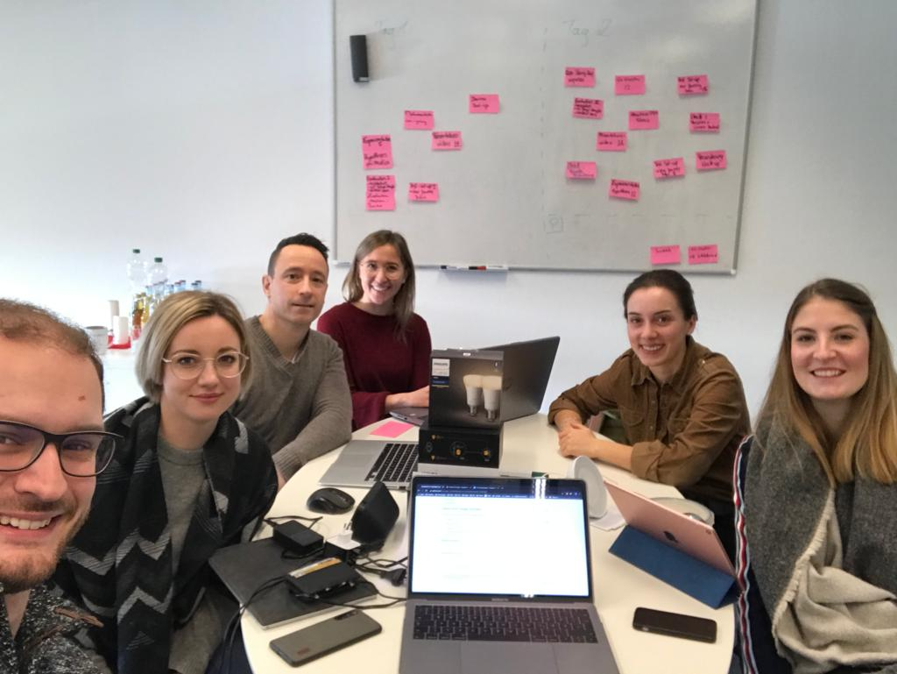
Concept
With the goal of creating a user-centered IoT solution minimum viable product (MVP) for a restaurant replicator, we applied the Living Lab research method during the hackathon, where we took the IoT design principles as well as the IoT product-service logic of Elgar Fleisch into account and documented all project findings and results in this repository. The result of our IoT project:
F O O D L E

Slide 3
Lean Canvas
Cook meal
Shop ingredients
Create suitable atmosphere
Foodle is a cooking appliance, which provides delicouse food in combination with the right atmosphere just like in a restaurant
Get your own restaurant feeling at home with one order in our app.
Automated delivery of ingredients
Automated creation of the right atmosphere
Automated cooking of your ordered food
Combination of meal and the right atmosphere created automatically
People with busy lifestyle
Cooking newbies
Restaurant lovers
Number of subscriptions
Number of orders
Satisfaction index
Social Media
Cooperation with delivery service of supermarkets/ HelloFresh
Fair
Cooking appliance
Delivery-Service of supermarkets
Restaurant
IoT-Service for your own restaurant feeling at home
Cooking newbies with an affinity to IoT devices
Development and maintenance of app
Monthly subscriptions
Single order per meal

Slide 4
Bridging the gap – ‘Formula by Elgar Fleisch‘
Thing
IT
Thing-based function
IT-based service

Slide 5

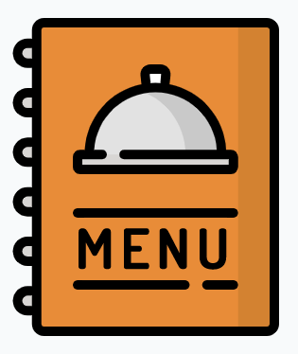
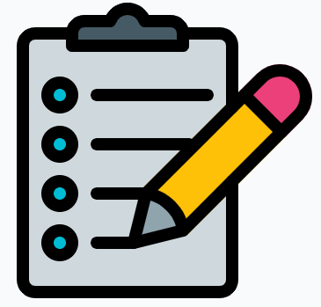
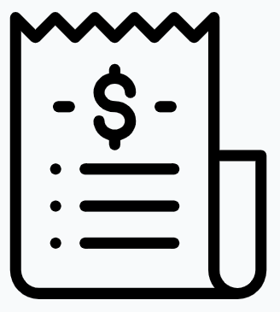
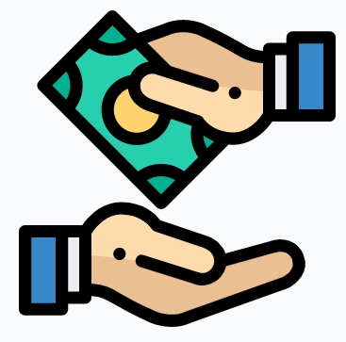
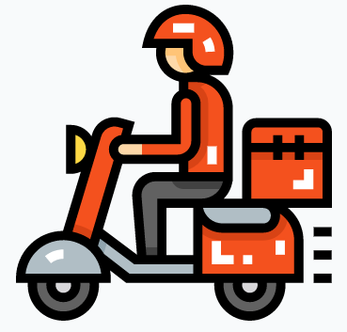

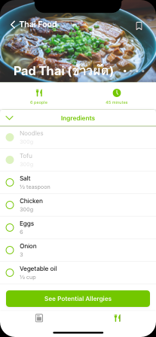
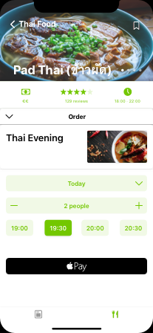
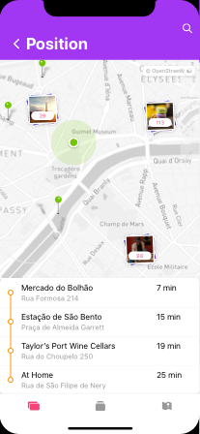
Key elements, media breaks and their elimination
Making table booking by phone
Ordering food with a physical menu
Taking orders with a physical notebook
Preparing the table bill
Paying the bill
Manual scanning of the NFC tag to adopt settings

Slide 6
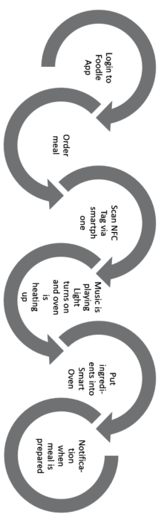
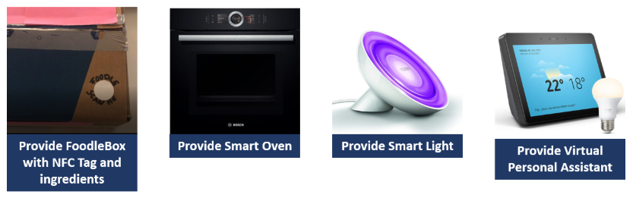
Test Set-up Iteration 1

Slide 7

Lessons Learned (Evaluation Iteration 1)
Validation of Hypothesis
Identified Issues:
In order to write the needed information on a NFC-tag, the supplier needs a specific device. In addition, they have to be cautious to put the tag on every box with the right tag. Once the tag is missing, it is not possible to activate the system.
User has still a lot of manual steps until he can enjoy his meal. The current process does not differ much from a simple (pizza) order. On the contrary, the user has to scan a tag, before he can even start the meal preparation and the creation of the atmosphere. This step is usually not present in a restaurant.
Depending on the meal, the cooking and possible preparation time can take up 40 min to one hour. In a restaurant you also have waiting time but it seldom goes up to one hour.
Design Principles
Media Breaks

Slide 8
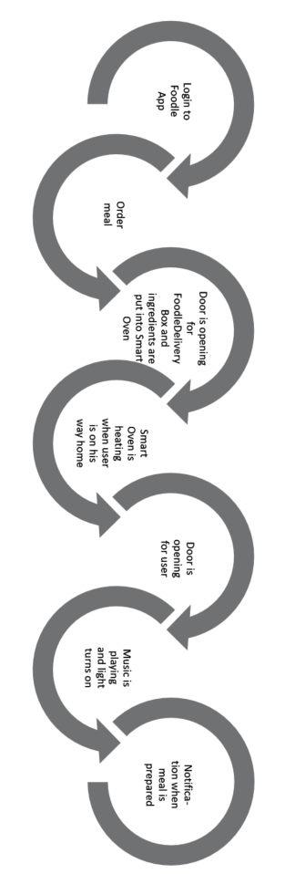
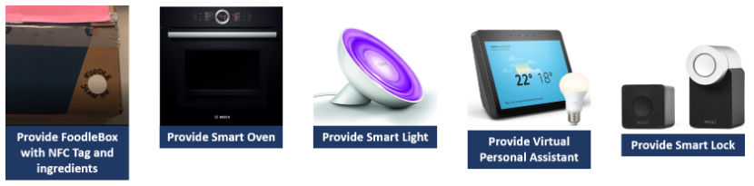
Test Set-up Iteration 2

Slide 9
Lessons Learned (Evaluation Iteration 2)
Validation of Hypothesis
Identified Issues:
The application is only available for smartphones at the moment. People preferably using wearables may experience less of a customer experience. Our target group is also an intensive user of voice assistants such as Alexa or Siri. This function is also still not implemented.
During the meal order the uses gets generic proposition and has to search for the favorite dishes with the search possibility. The system does not yet learn what preferences the user has.
Design Principles
Media Breaks

Slide 10
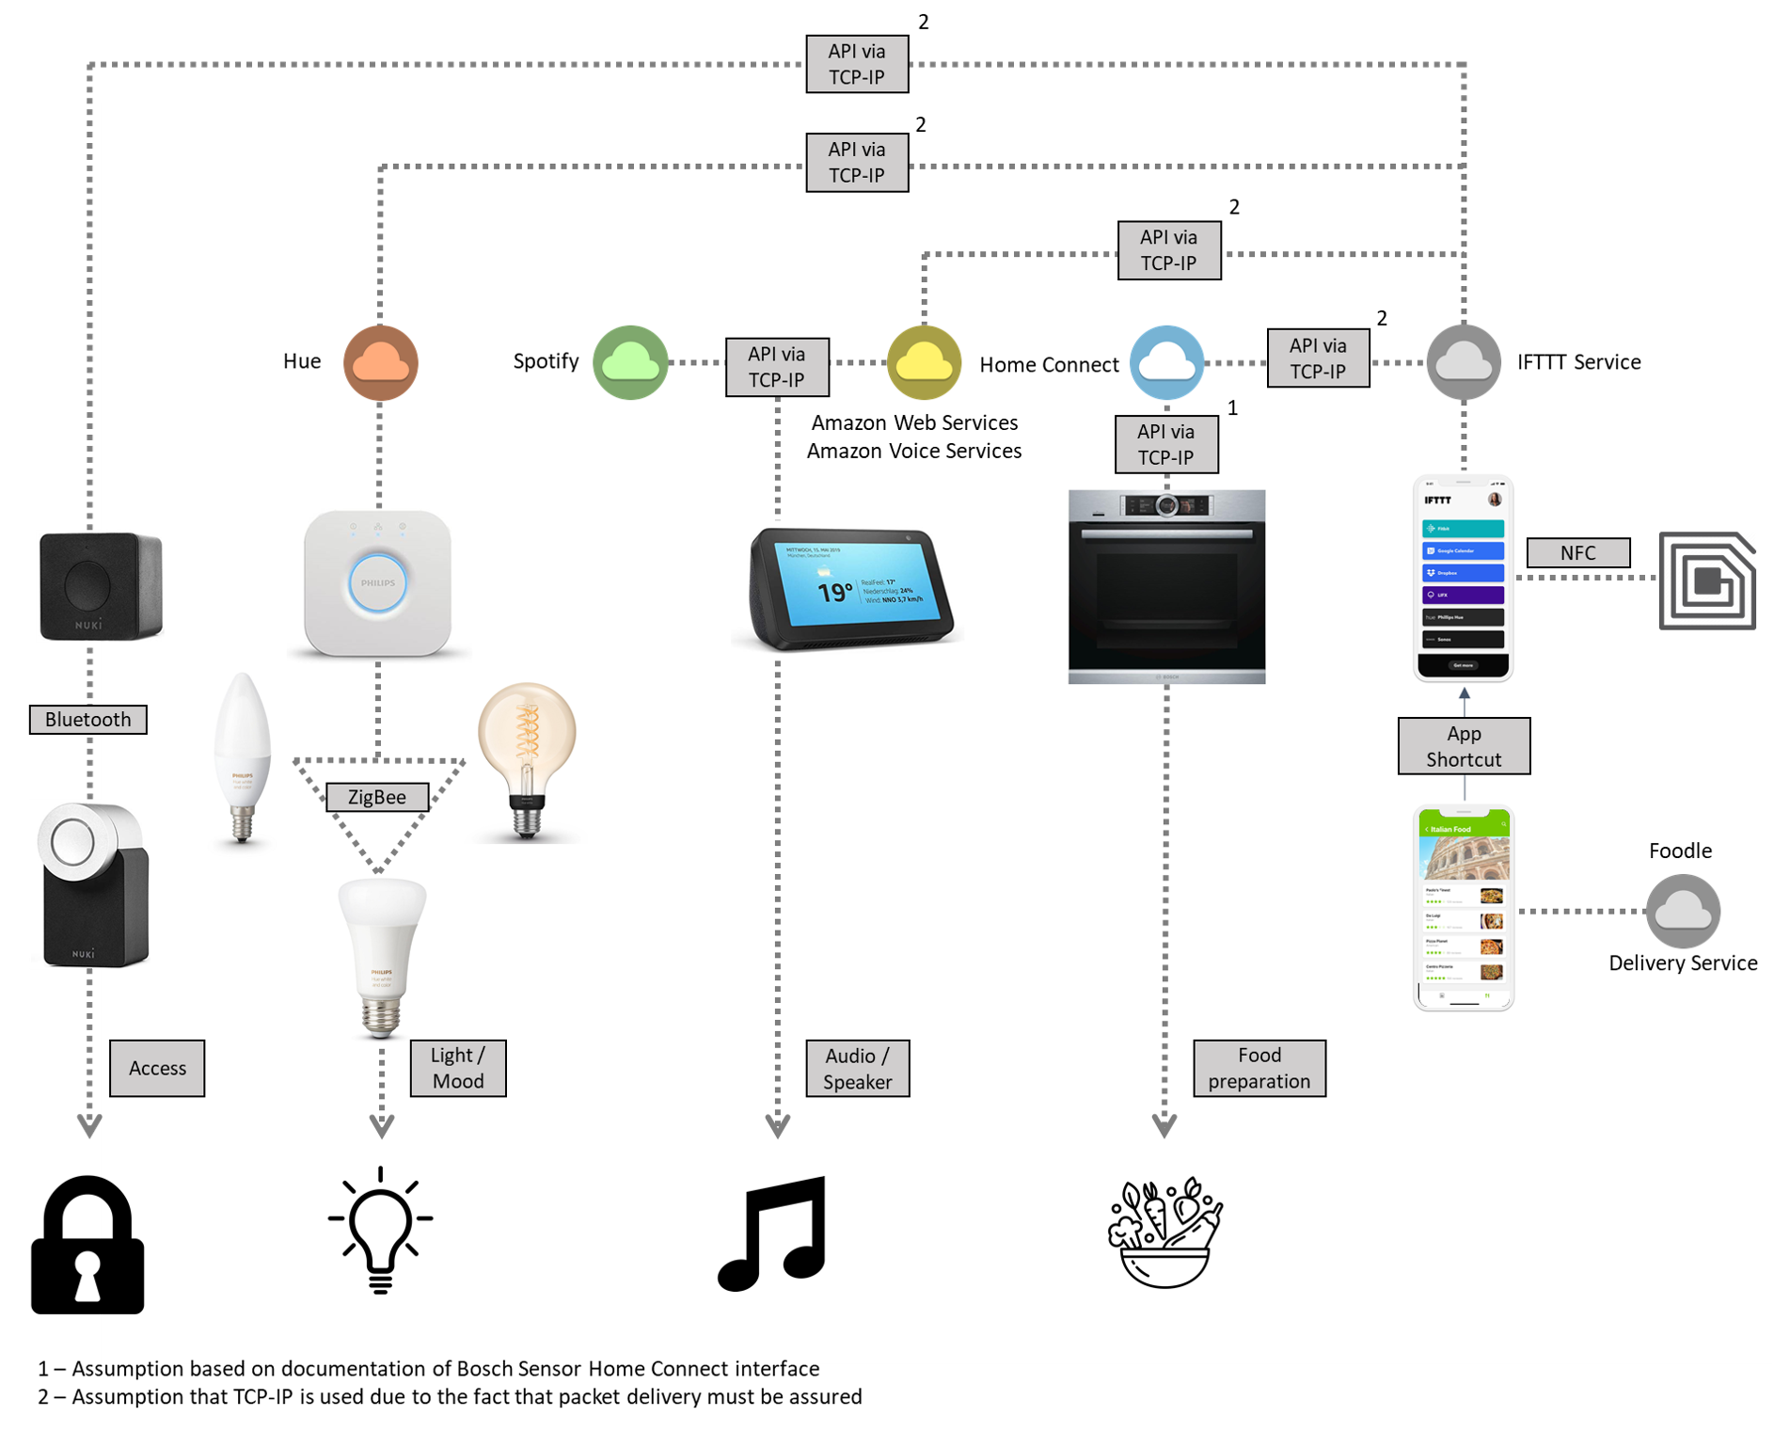
Communication

Slide 11
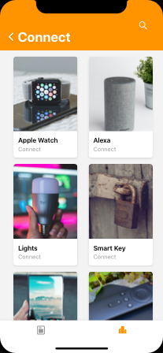
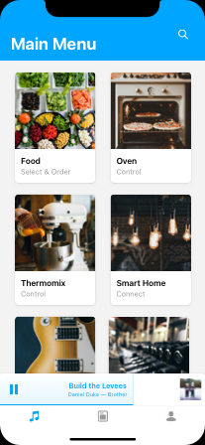
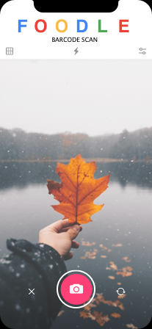
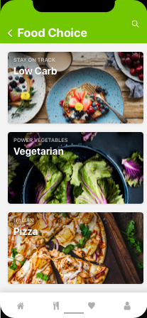
Mock-Up Examples

Slide 12
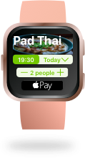
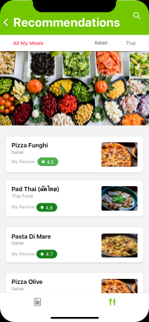
Summary & Outlook
F O O D L E allows the customer a meal choice based on personalized eating habits and the automatic transmission of cooking settings to the smart kitchen devices as well as automatic Delivery Services and meal cooking before arrival of the customer.
Link Foodle with social media accounts
Connect my wearable(s) with Foodle
Receive seasonal and local meal recommendations
Connect other Apps with Foodle
Receive meal recommendations based on past choices and likes

Slide 13
Explanatory Videos
Please find our project-related videos by clicking on the following links:
https://www.youtube.com/watch?v=UC87j2zOXUU&feature=youtu.be
https://www.youtube.com/watch?v=cUxaSEDWjLk&feature=youtu.be
https://www.youtube.com/watch?v=aRMPMNplUuQ&feature=youtu.be

